Slide 1
AUTOMED 2021
Benicio López de Letona
Aarón Ladrón de Guevara

Slide 2
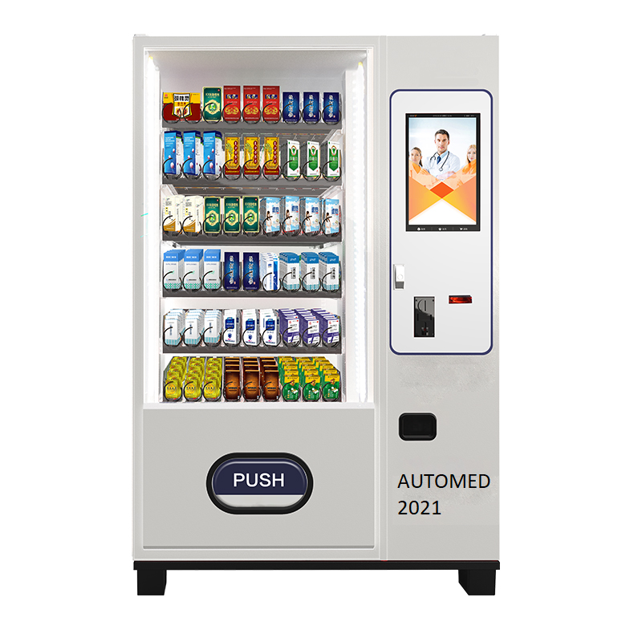
INTRODUCTION
Our project is a vending machine which sells medicines 24h a day. You can buy generic medicines without prescription like aspirines, or medicines that are prescribed by a doctor thanks to the prescription reader in the machine.

Slide 3
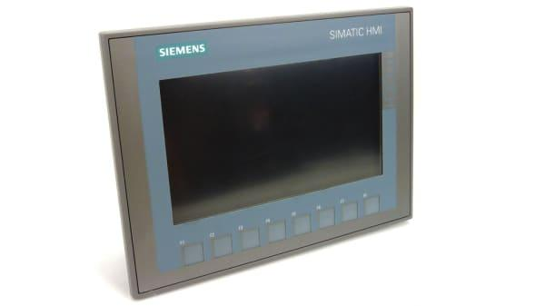
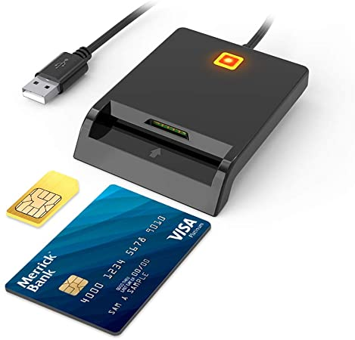
HOW TO USE IT
The Automed machine works the following way:
First you have to choose the medicine you want to buy in the HMI screen, which is tactile and is always on service.
-If you want a non-prescribed medicine you choose it on the screen items.
- If the medicine is prescribed by a doctor you identify yourself with your medical card by putting it in the card reader.
After that you have to pay the price; the machine will give you then your medicines.
Notes:
The Automed machine works the following way:
• First you have to choose the medicine you want to buy in the HMI screen, which is tactile and is always on service.
- If you want a non-prescribed medicine you choose it on the screen items.
- If the medicine is prescribed by a doctor you identify yourself with your medical card by putting it in the card reader.
• After that you have to pay the price; the machine will give you then your medicines.

Slide 4
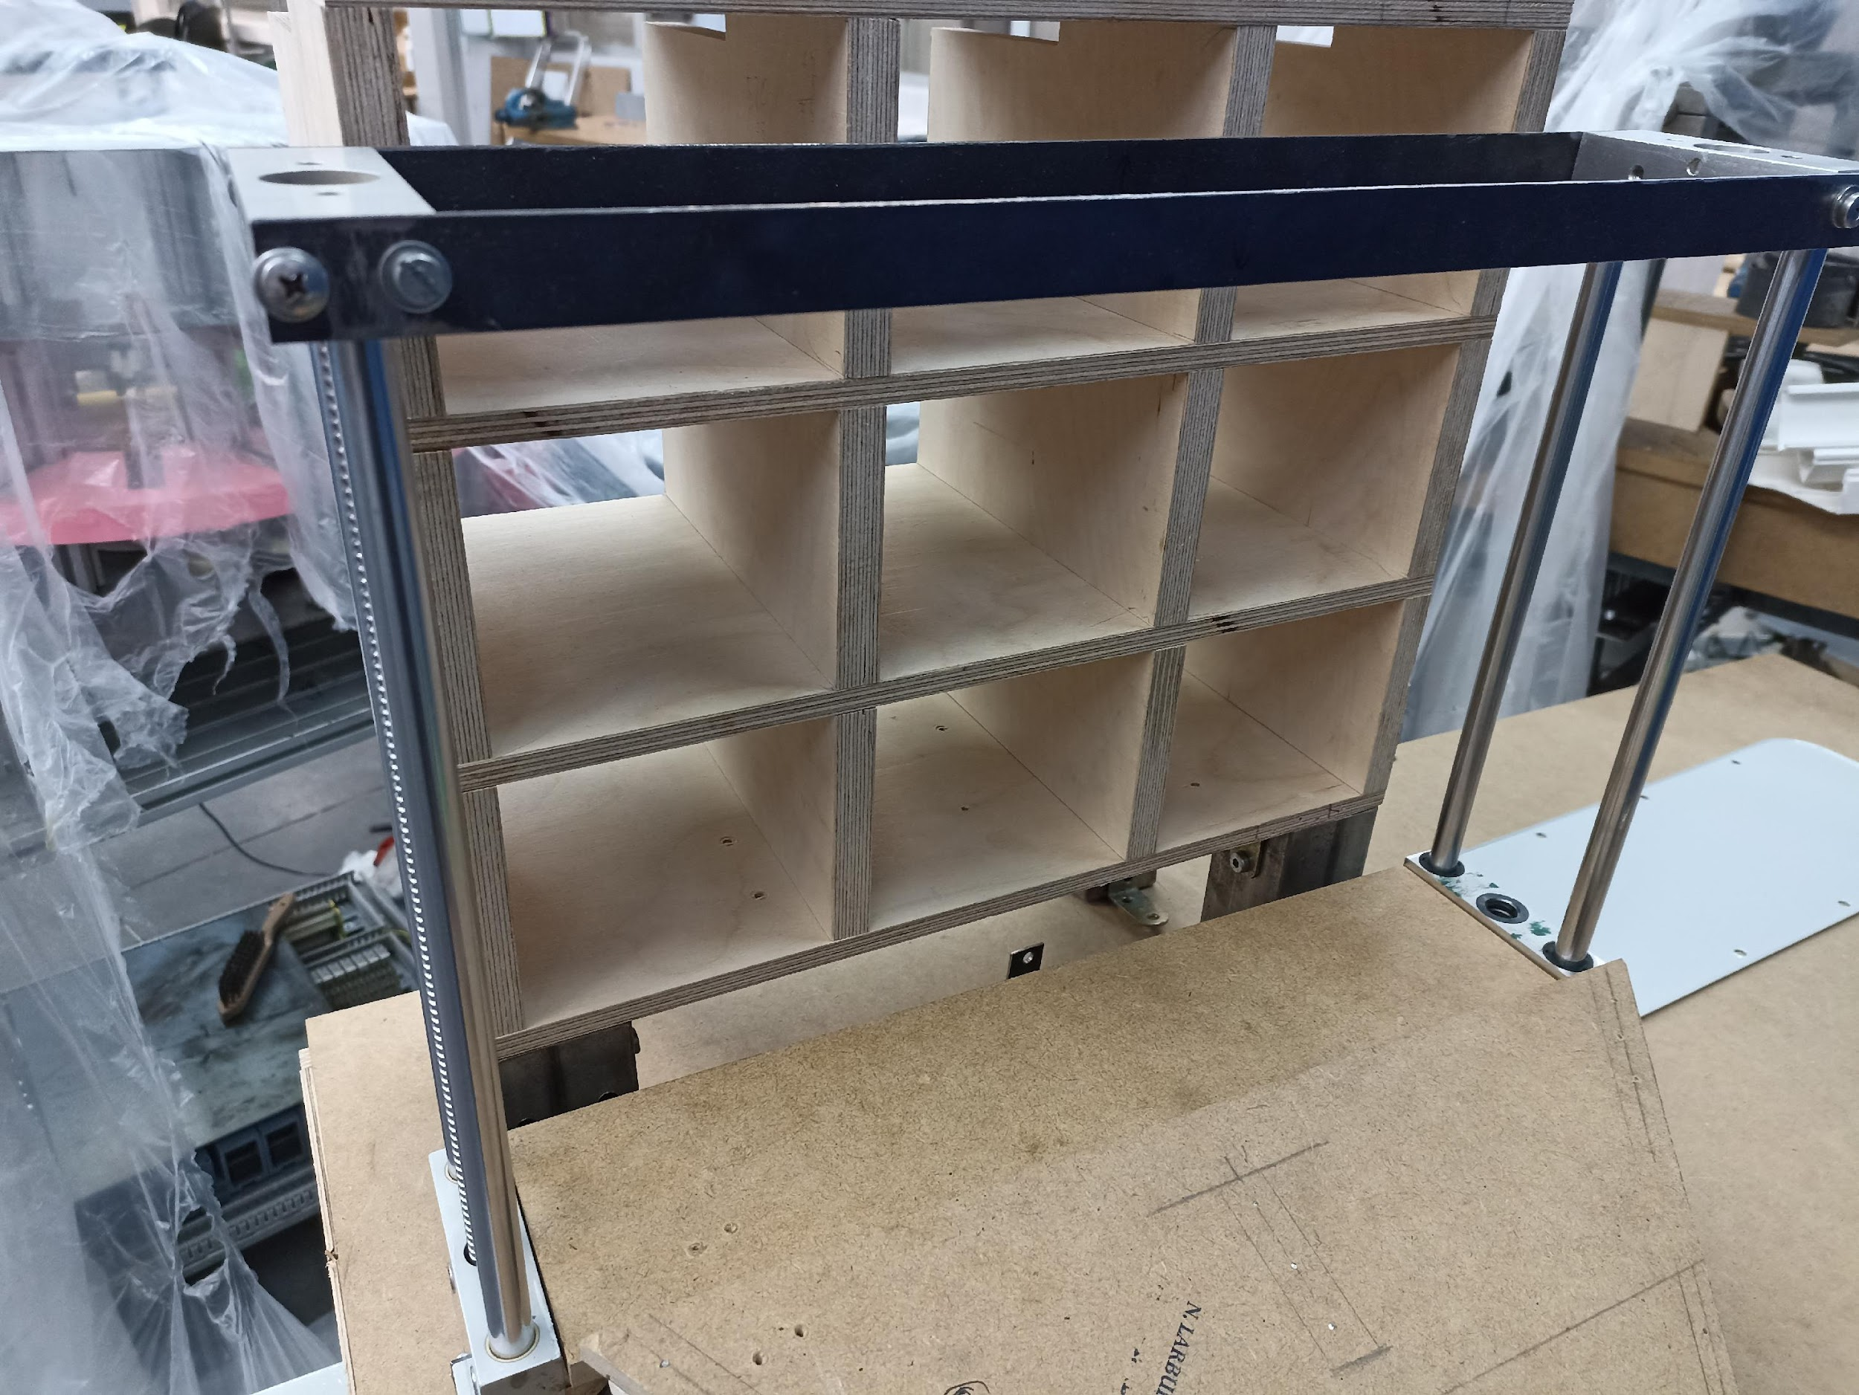
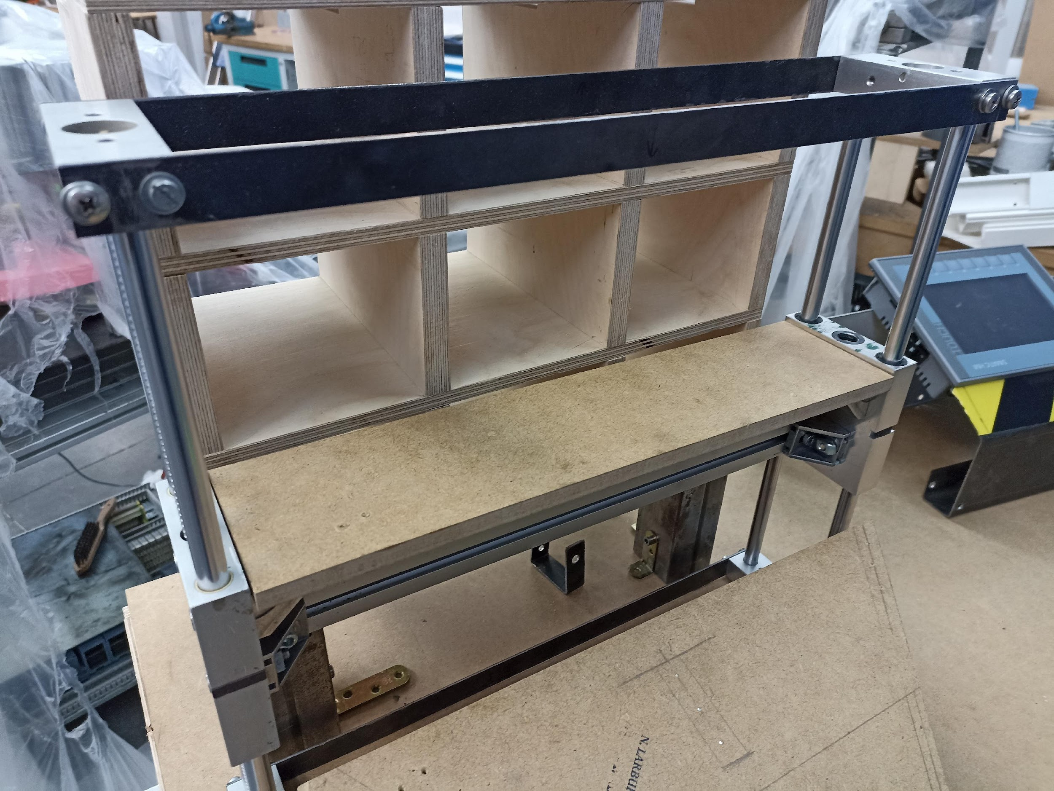
HOW IT WORKS
The Automed machine works the following way:
It starts the process after the client has chosen the medicine and payed for it.
First the machine activates the medicine elevator, that goes from the base level to the level where the medicine is placed.
Notes:
The Automated machine works the following way:
It starts the process after the client has chosen the medicine and payed for it.
First the machine activates the medicine elevator, that goes from the base level to the level where the medicine is placed.

Slide 5
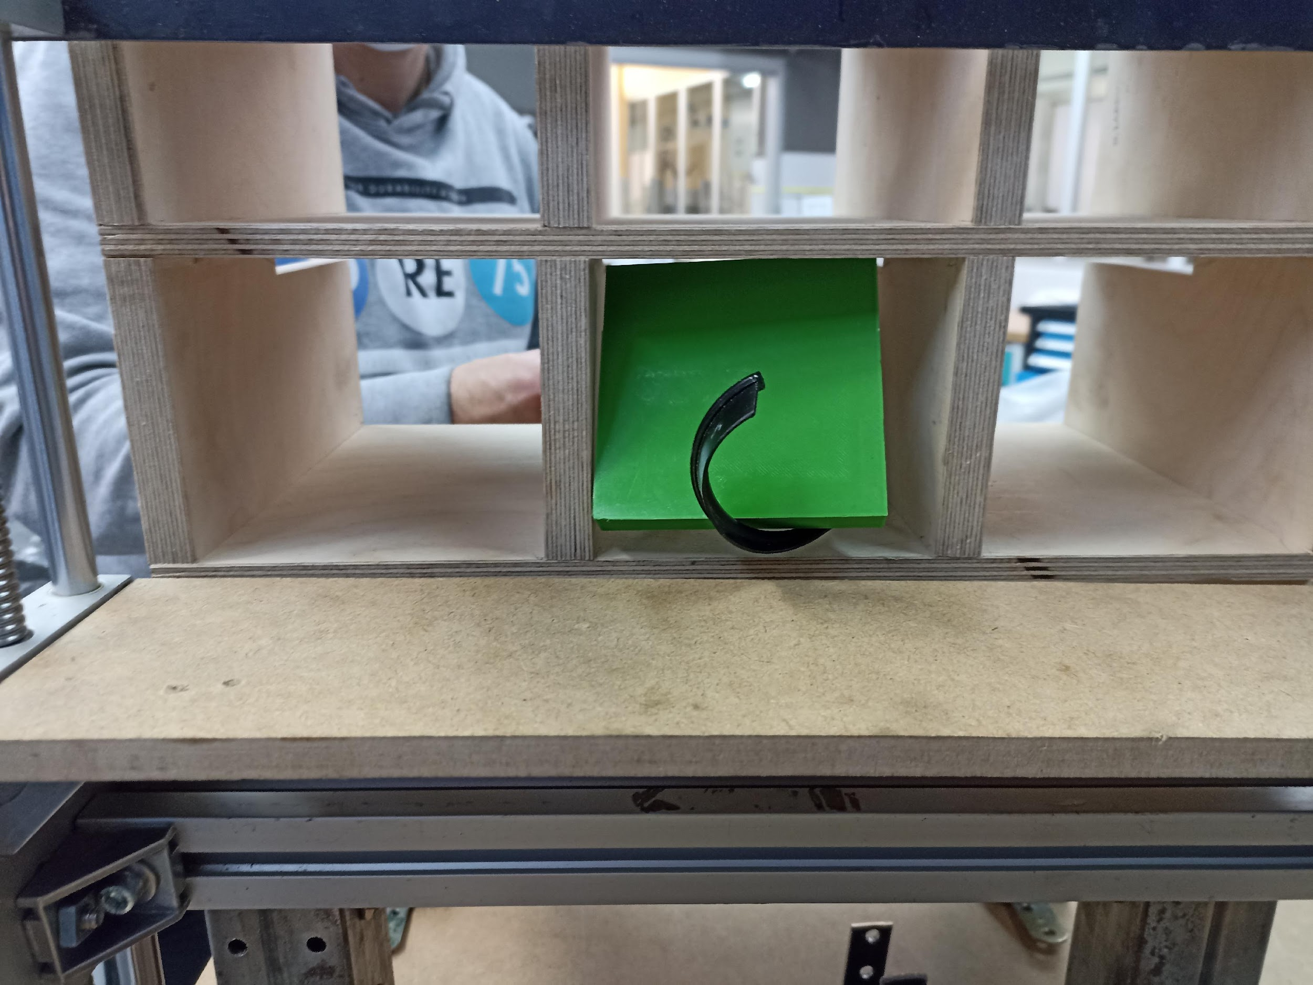
After that, the motor of the serving spiral is turned on. The medicine placed on the spiral falls into the elevator.
Notes:
t, the serving Aft
After that, the motor of the serving spiral where the chosen medicine is placed is turned on. The medicine falls into the elevator
er that, the motor of the serving spiral where the chosen medicine is placed is turned on. The medic
After that, the motor of the serving spiral where the chosen medicine is placed is turned on. The medicine falls into the elevator.
ine falls into the elevator. spiral, w chosen medicine is placed, turns on its motor until the medicine fall

Slide 6
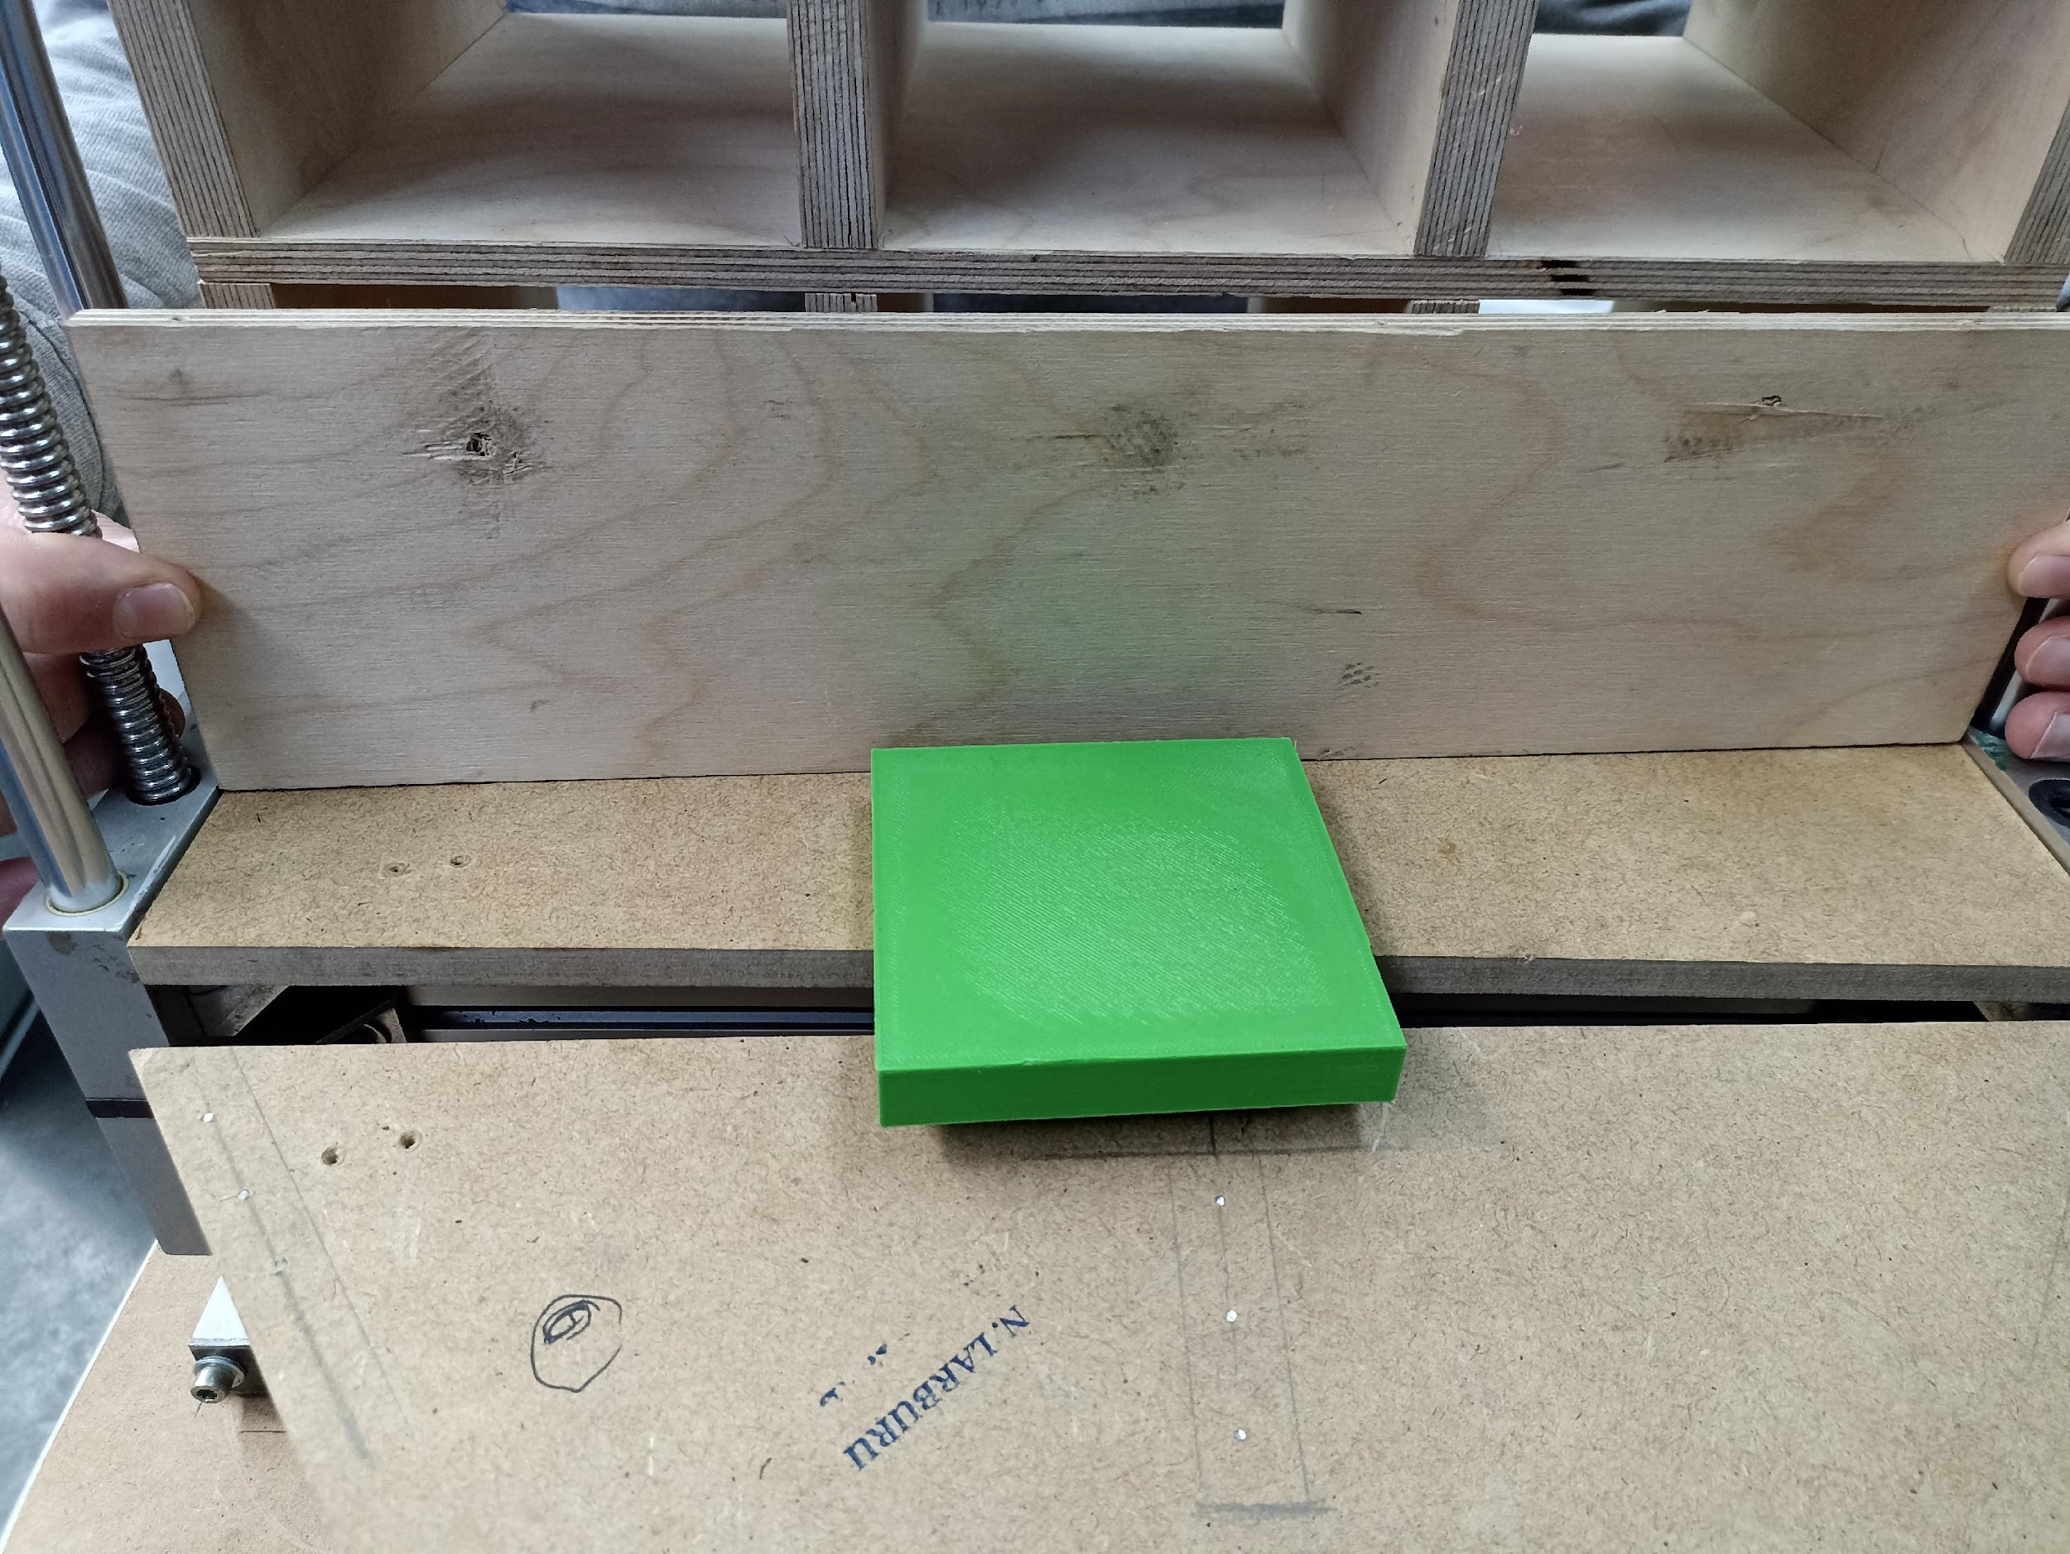
Next the elevator goes down back to the base level;then an ejector cylinder pushes the medicine in the elevator to the ramp.
Notes:
Next the elevator goes down back to the base level; then an ejector cylinder pushes the medicine in the elevator to the ramp.

Slide 7
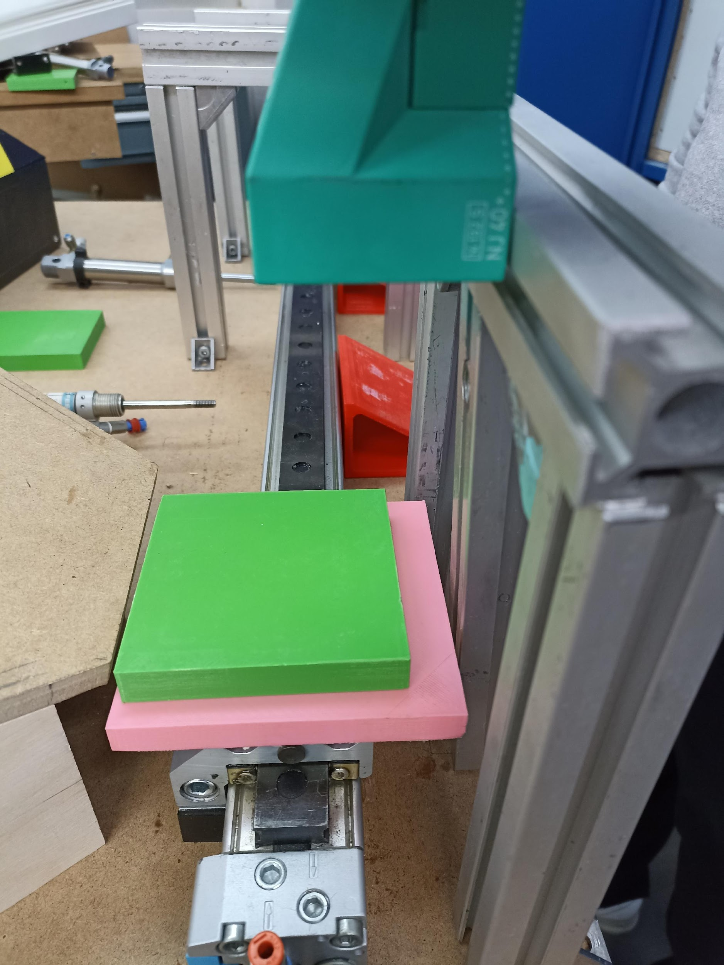
Then the medicine is placed on the linear displacer, where a verification camera checks that everything is right with the medicine.
Notes:
Then the medicine is placed on the linear displacer, where a verification camera checks that everything is right with the medicine.

Slide 8
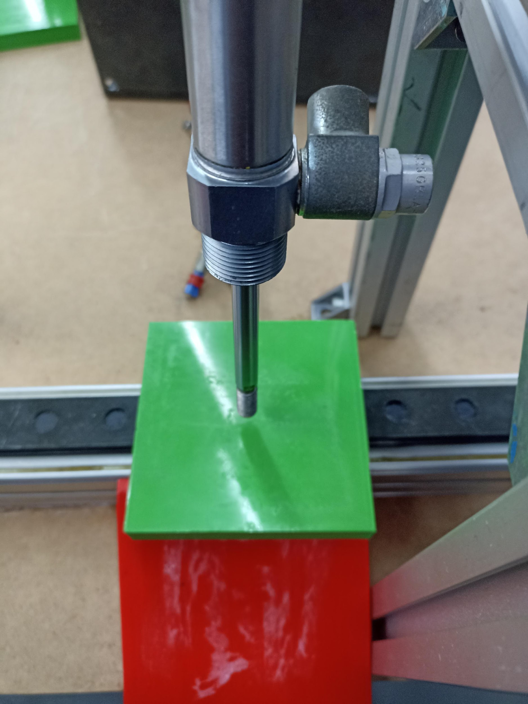
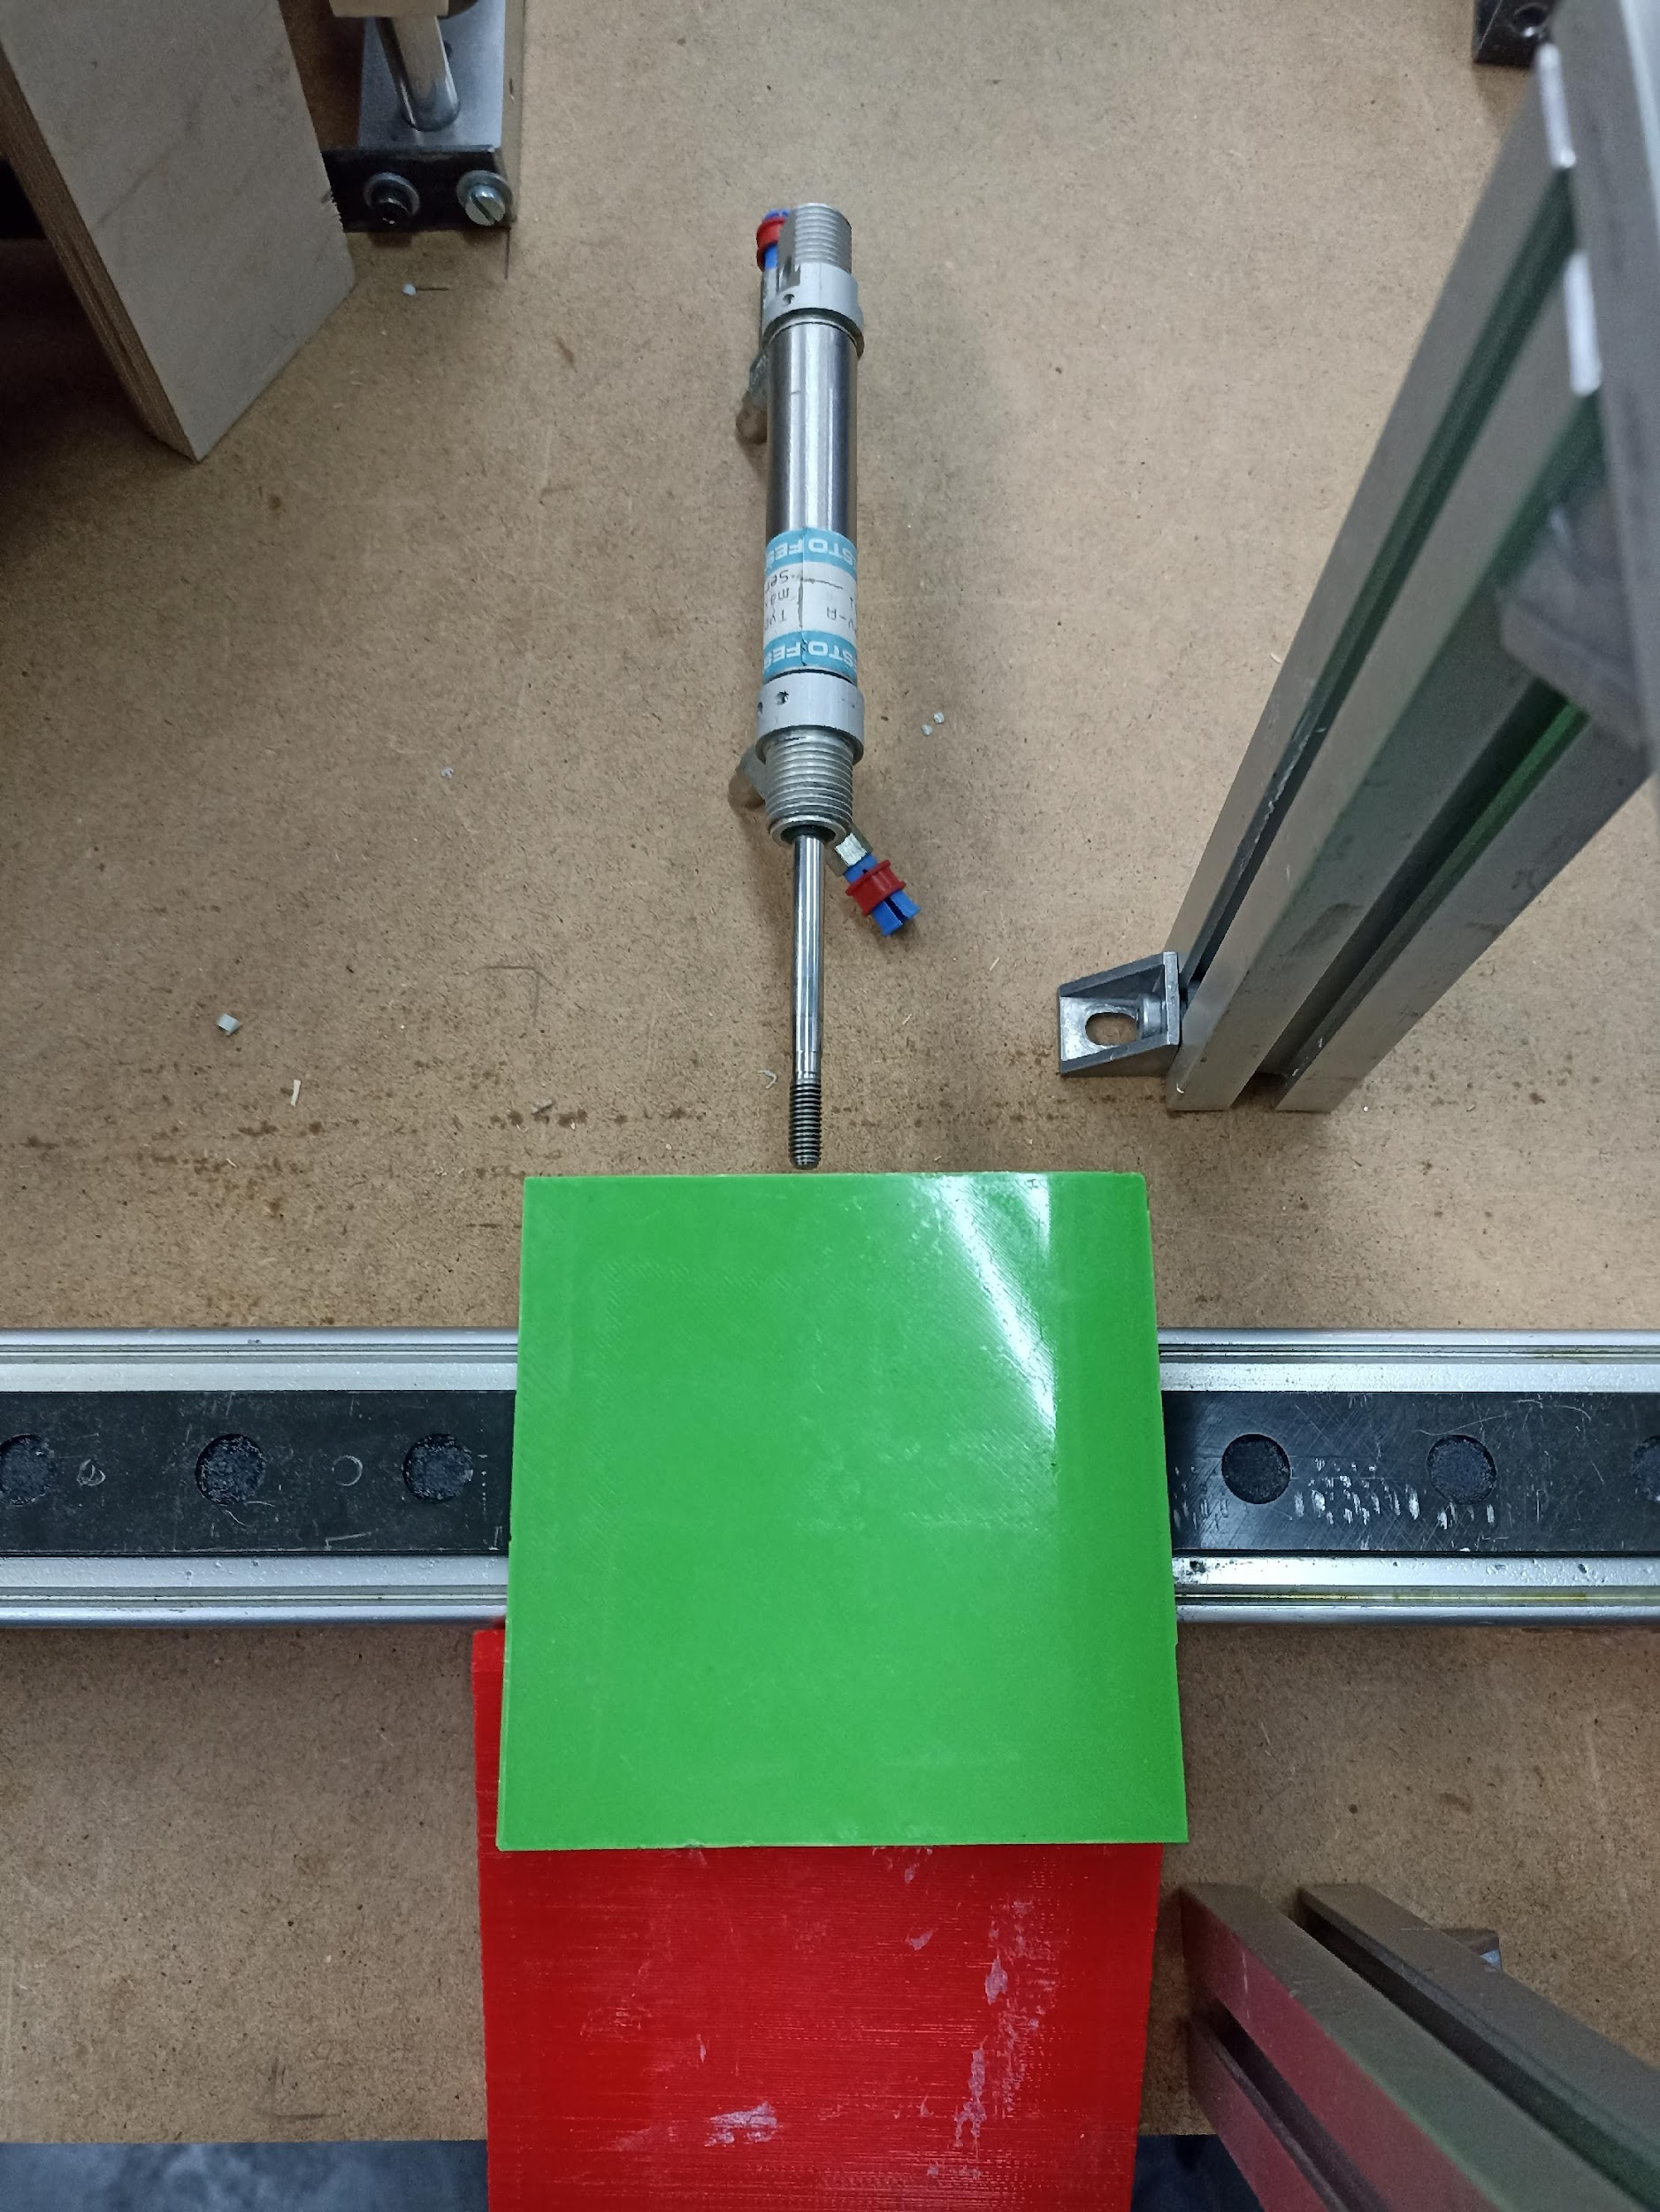
If the medicine is ok, the linear displacer carries it to the stamping point where a cylinder stamps it with the date and the warranty stamp. After that the displacer carries it to the delivery point where finally another cylinder pushes it to the pickup cage.
Notes:
If the medicine is ok, the linear displacer carries it to the stamping point where a cylinder stamps it with the date and the warranty stamp. After that the displacer carries it to the delivery point where finally another cylinder pushes it to the pickup cage.

Slide 9
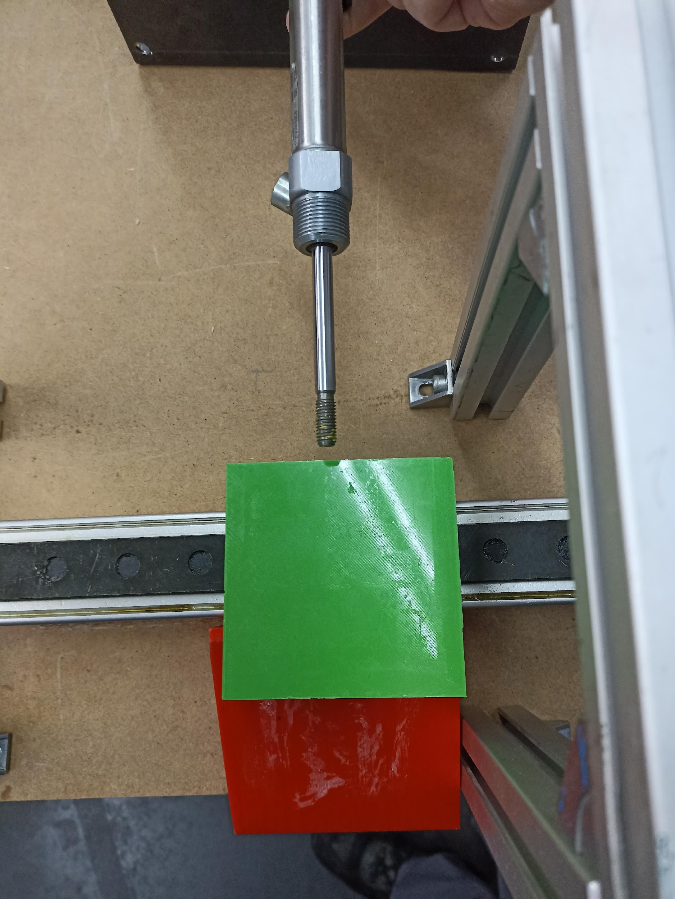
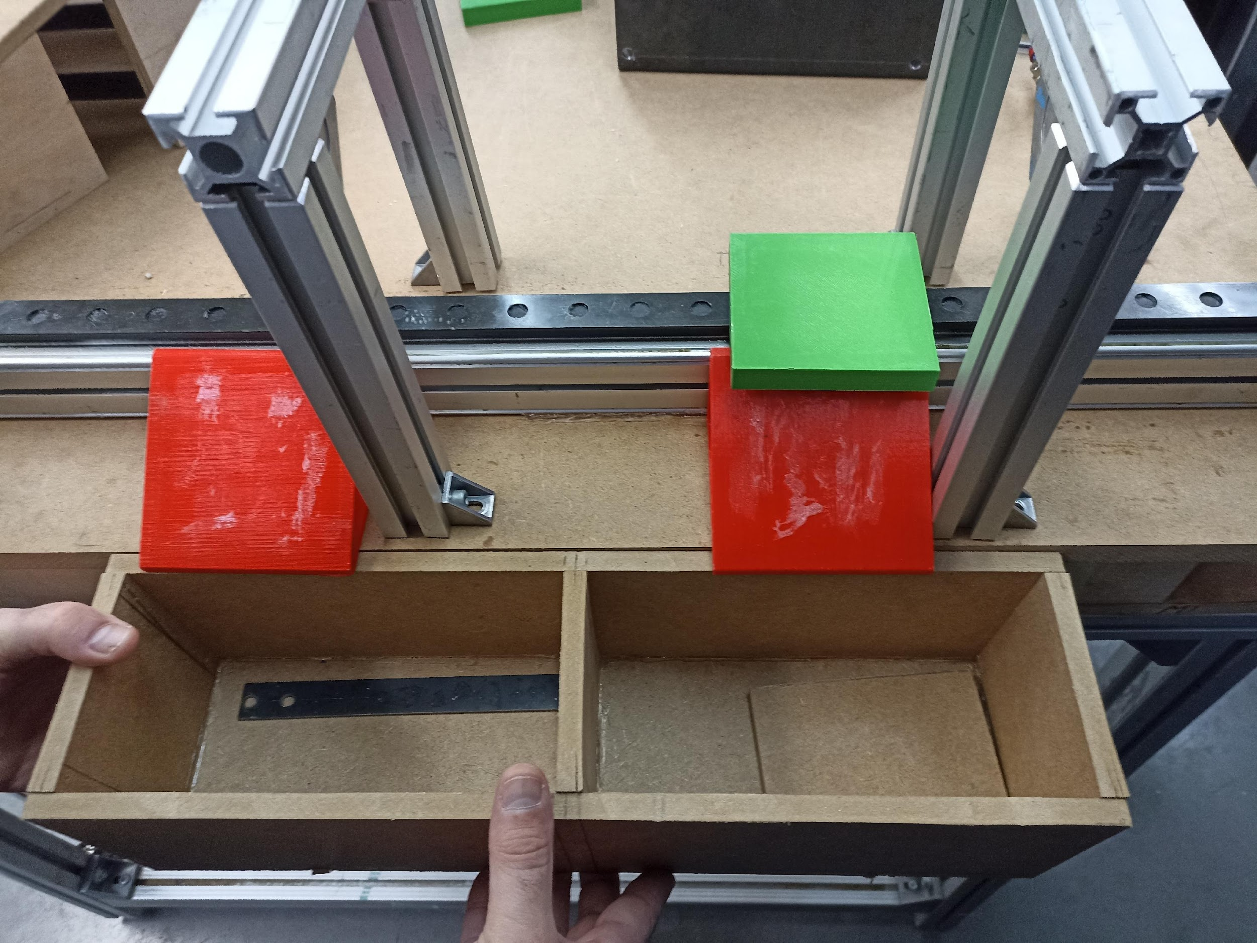
If the medicine is not ok, the displacer carries it to the discard point where a cylinder pushes it to the discard cage and the HMI screen informs to the client that the medicine is not ok. Finally the Automed gives the money back to the client.
Notes:
If the medicine is not ok, the displacer carries it to the discard point where a cylinder pushes it to the discard cage and the HMI screen informs the client that the medicine is not ok. Finally the Automed gives the money back to the client.

Slide 10
Conclusions:
We can say that our machine is able to dispense medicines to customers in a simple way, with quite an intuitive handling.
In addition, in case of detecting an error, it is prepared to give the money back to the customers on site, without the need to file any claim.

